Slide 1


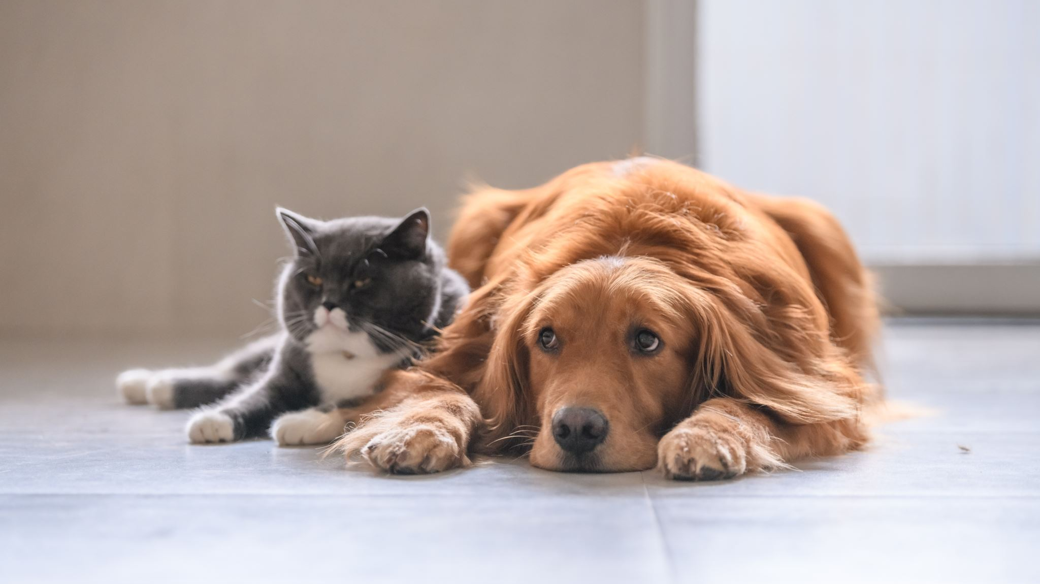
PETS CLINIC MANAGEMENT SYSTEM

Slide 2

“Overview”
The "Pets Clinic Management System" has been developed to override the problems prevailing in the practicing manual system. This software is supported to eliminate and, in some cases, reduce the hardships faced by this existing system.
The "Pets Clinic Management System" is designed to be easy to use and understand. It includes a user-friendly interface, so that you can quickly and easily access the information you need. The system also includes a variety of features, such as appointment scheduling, clinic information, and notifications

Slide 3
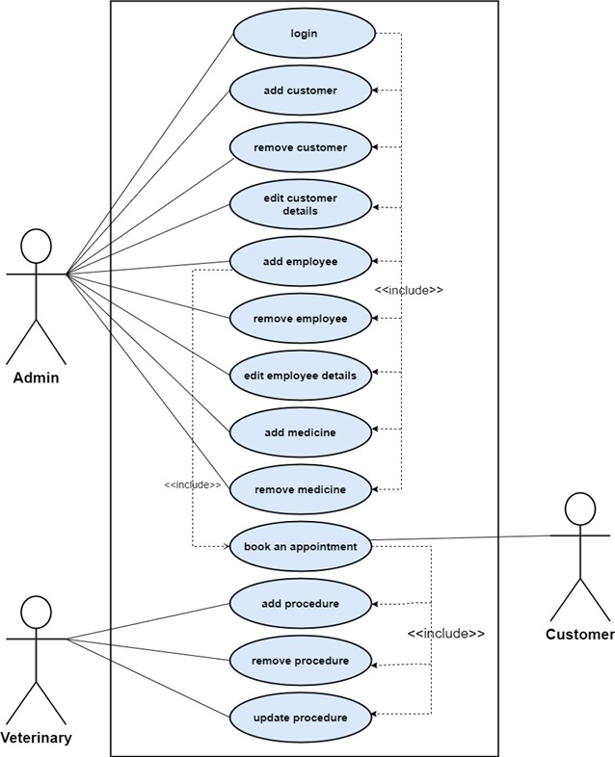
Use case diagram
describing an interaction between a user and a system. It displays the relationship among actors and use cases.

Slide 4

Activity diagram
Activity diagram is a flowchart that shows activities performed by each use case in a system

Slide 5
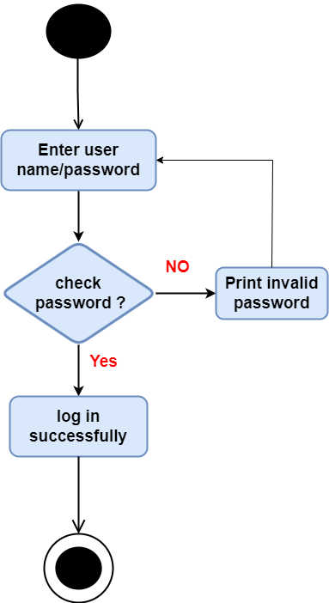
“Login”
This use case describes the process of logging in the system by the administrator.

Slide 6
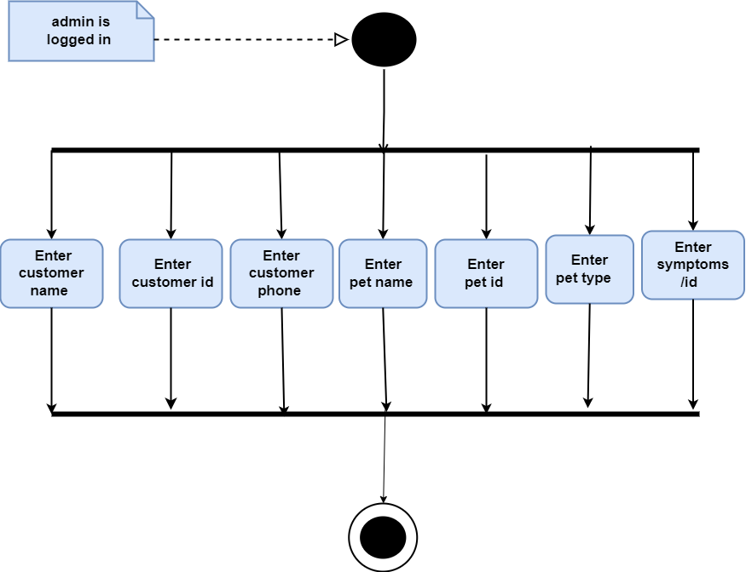
“Add customer”
This use case describes the process of adding the details of a customer by the administrator.

Slide 7
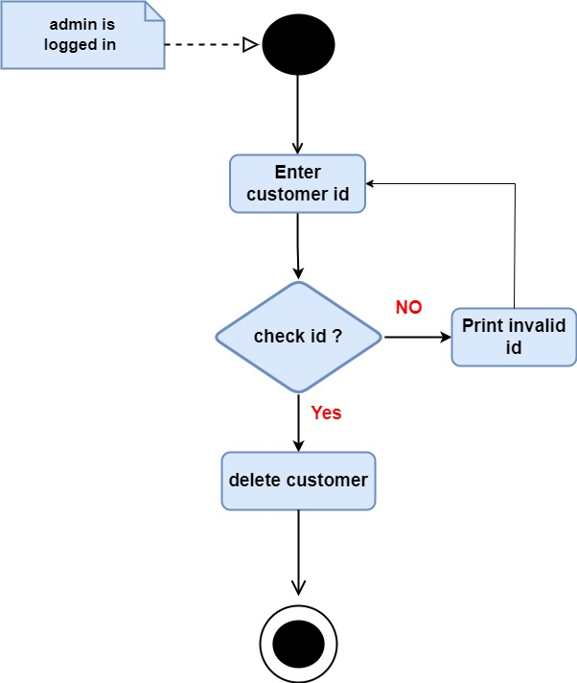
“Remove customer”
This use case describes the process of removing the details of a customer by the administrator.

Slide 8
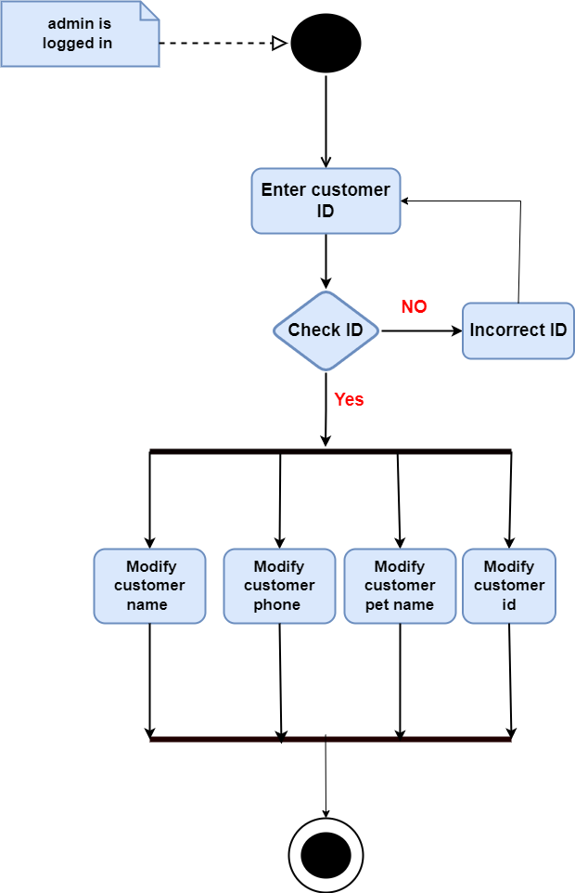
“Edit customer”
This use case describes the process of editing the details of a customer by the administrator.

Slide 9
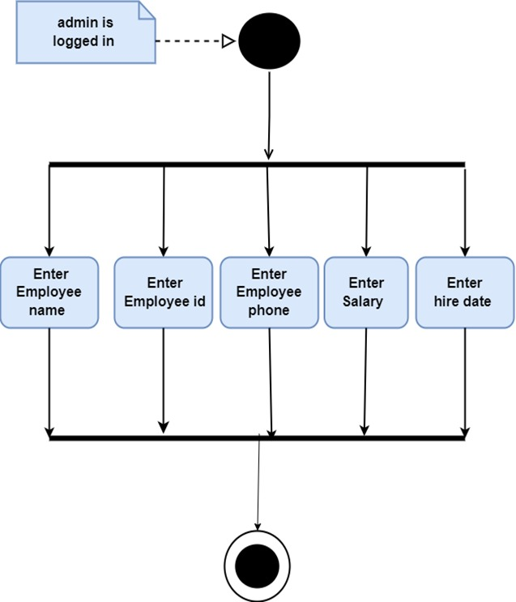
“Add employee”
This use case describes the process of adding the details of an employee by the administrator.

Slide 10
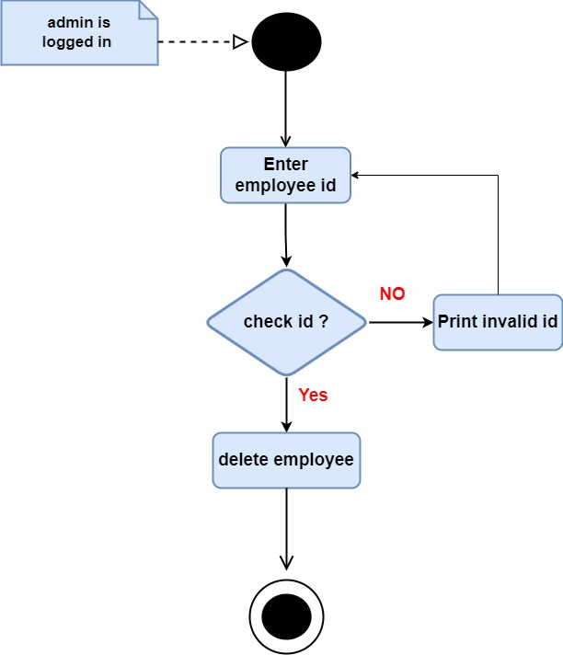
“Remove employee”
This use case describes the process of removing the details of an employee by the administrator

Slide 11
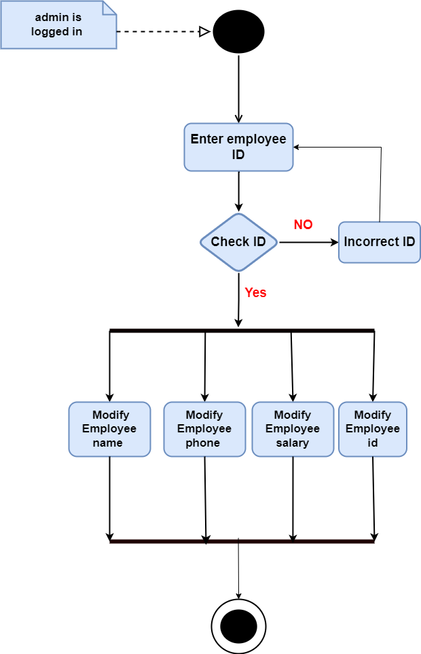
“Edit employee details”
This use case describes the process of editing the details of an employee by the administrator

Slide 12
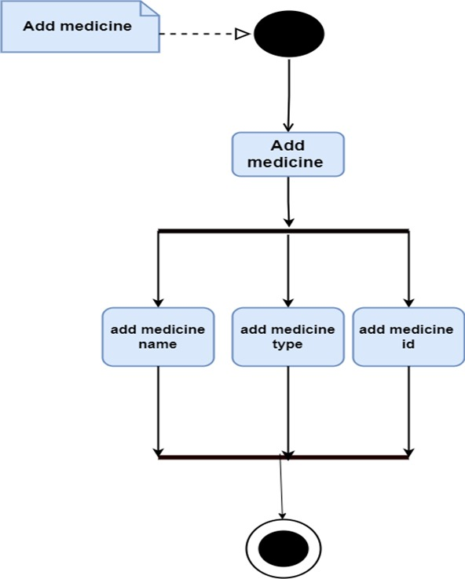
“Add medicine”
This use case describes the process of adding the medicine by the administrator.

Slide 13

“Remove medicine”
This use case describes the process of removing the medicine by the administrator.

Slide 14
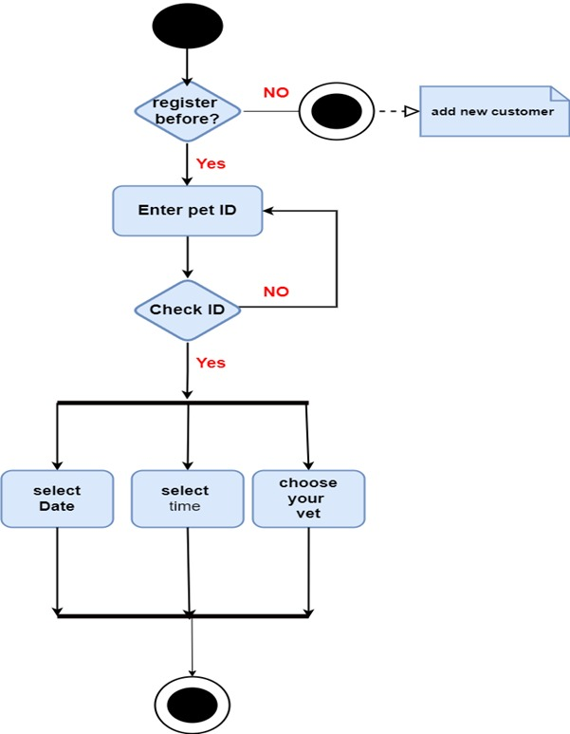
“Book appointment”
This use case describes the process of booking an appointment by the Customer.

Slide 15
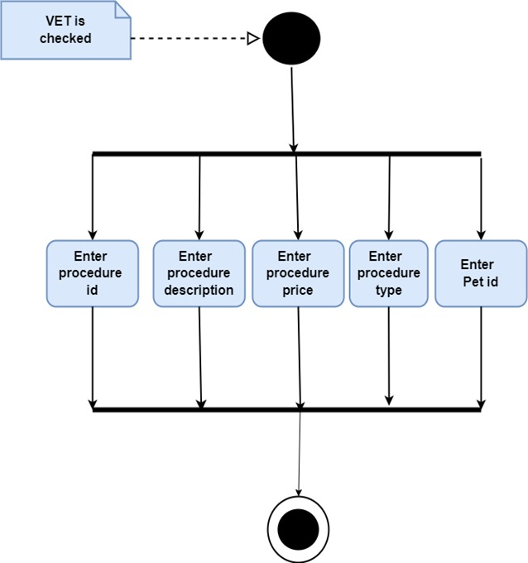
“Add procedure”
This use case describes the process of adding the details of procedure by the veterinarian.

Slide 16

“Remove procedure”
This use case describes the process of removing the procedure by the veterinarian.

Slide 17
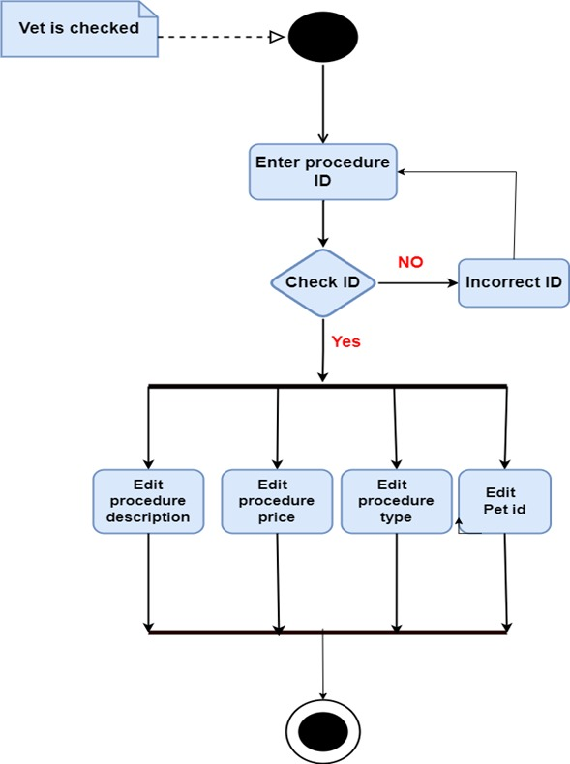
“Update procedure”
This use case describes the process of updating the details of procedure by the veterinarian.

Slide 18
Sequence diagram
Sequence Diagram is an interaction diagram that details how operations are carried out and what messages are sent and when

Slide 19
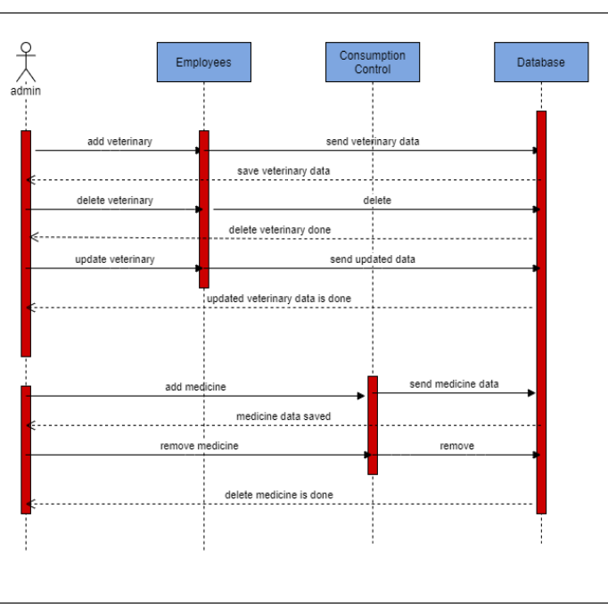
“Admin ”
Sequence diagram shows the sequence activities for admin

Slide 20
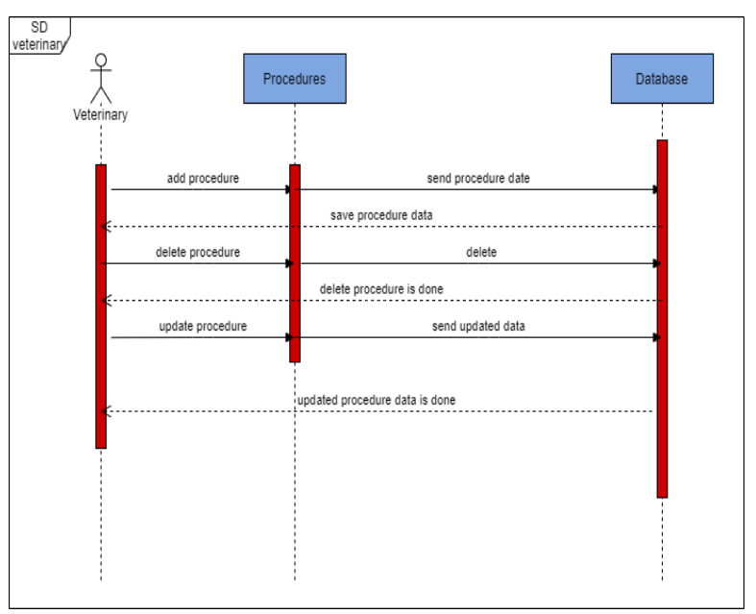
“Veterinary”
Sequence diagram shows the sequence activities for veterinary

Slide 21
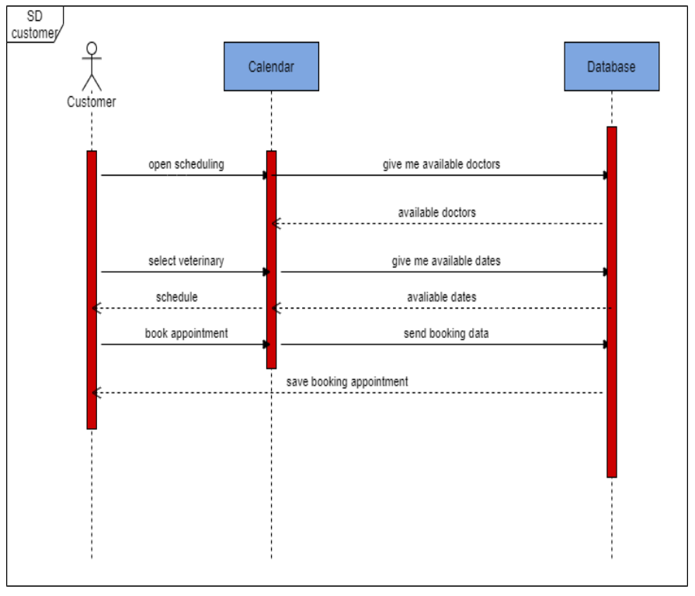
“Customer”
Sequence diagram shows the sequence activities for customer

Slide 22
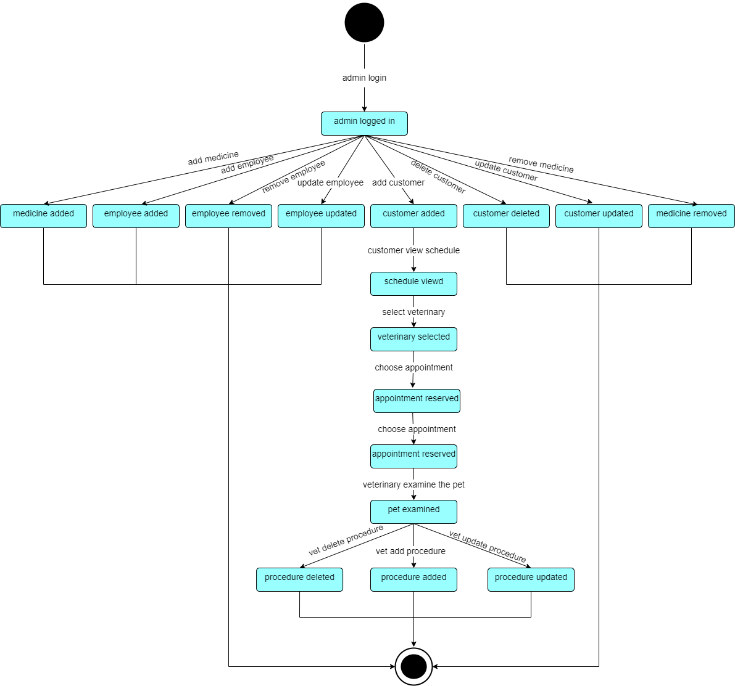
“State diagram”
Present the states an object can be in along with the transitions between the states and shows the starting point and endpoint of a sequence of state changes.

Slide 23
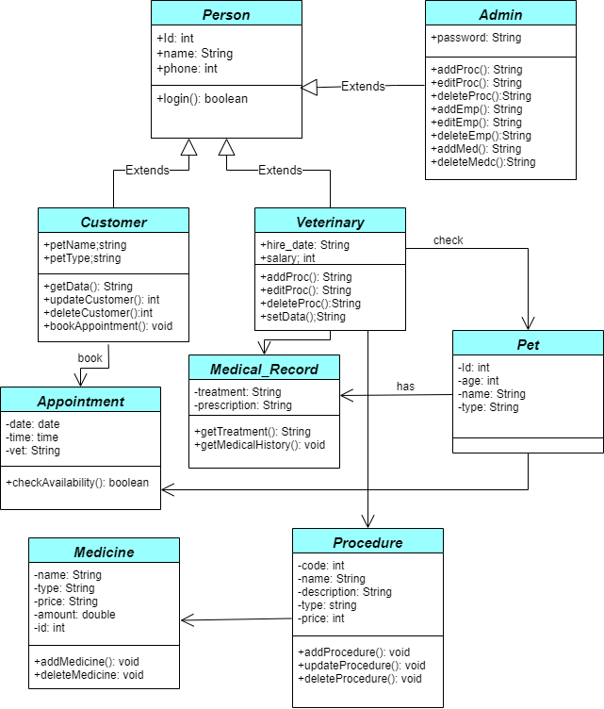
“Class diagram”
A class is the description of a set of objects having similar attributes, operations, relationships and behavior.

Slide 24
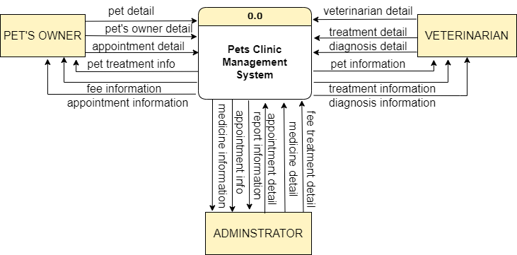
“Context diagram”
gives a broad overview of an information system and the way it interacts with external entities.

Slide 25
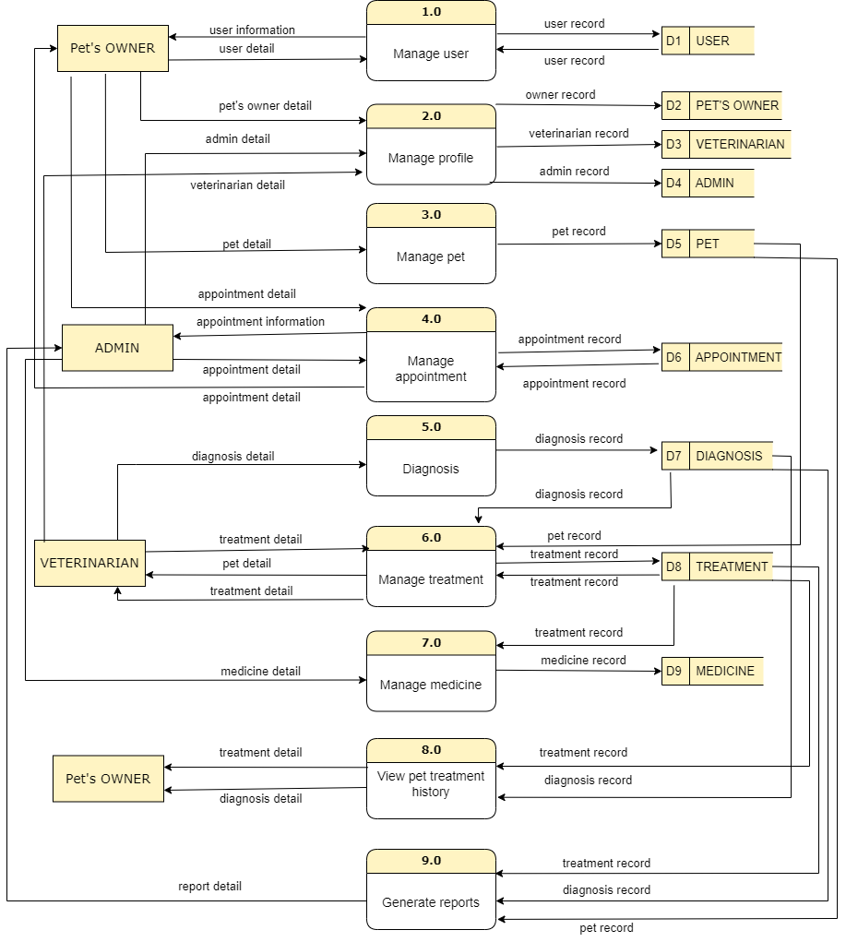
“Data flow diagram”
a picture of the movement of data between external entities and the processes and data stores within a system

Slide 26

GUI Design
GUIs help users do things within device, platform, program, or app without needing to type commands or know the coding behind the action

Slide 27

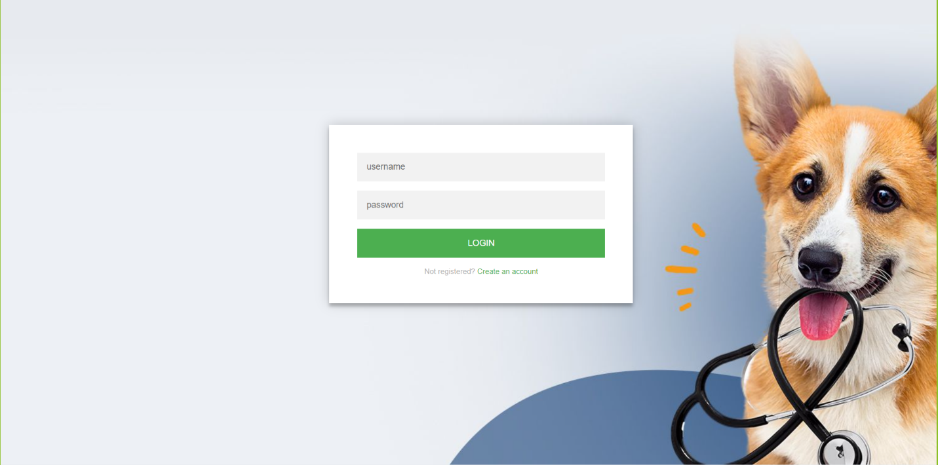
“Login Page”

Slide 28
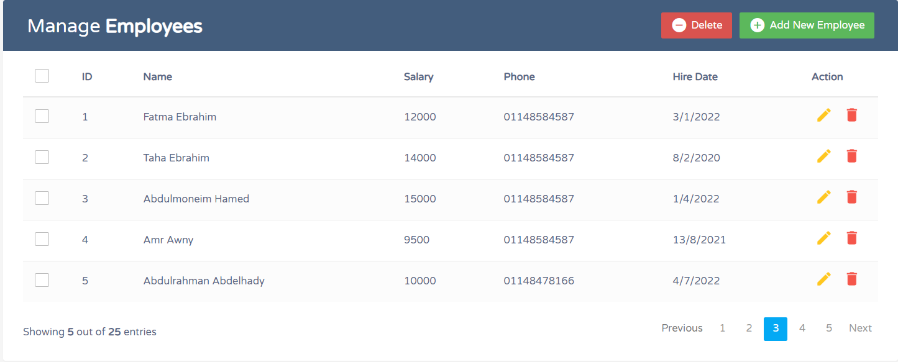
“Manage Employees Page”

Slide 29
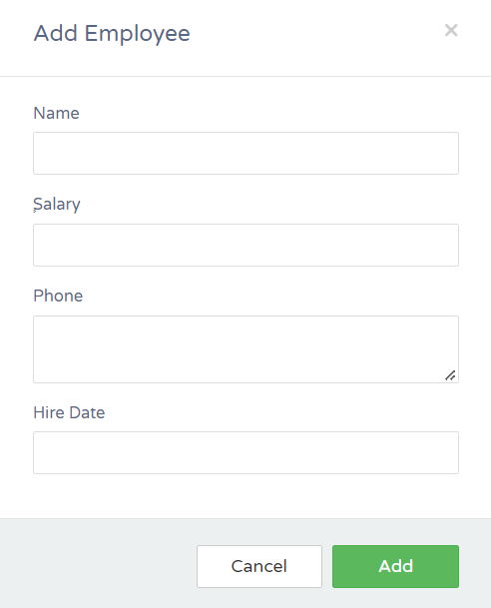
“Add employee page”

Slide 30
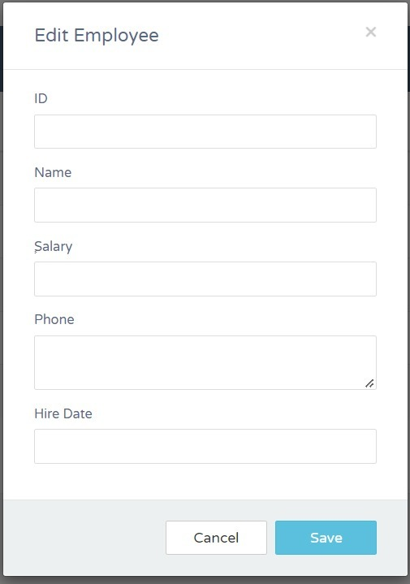
“Edit employee page”

Slide 31
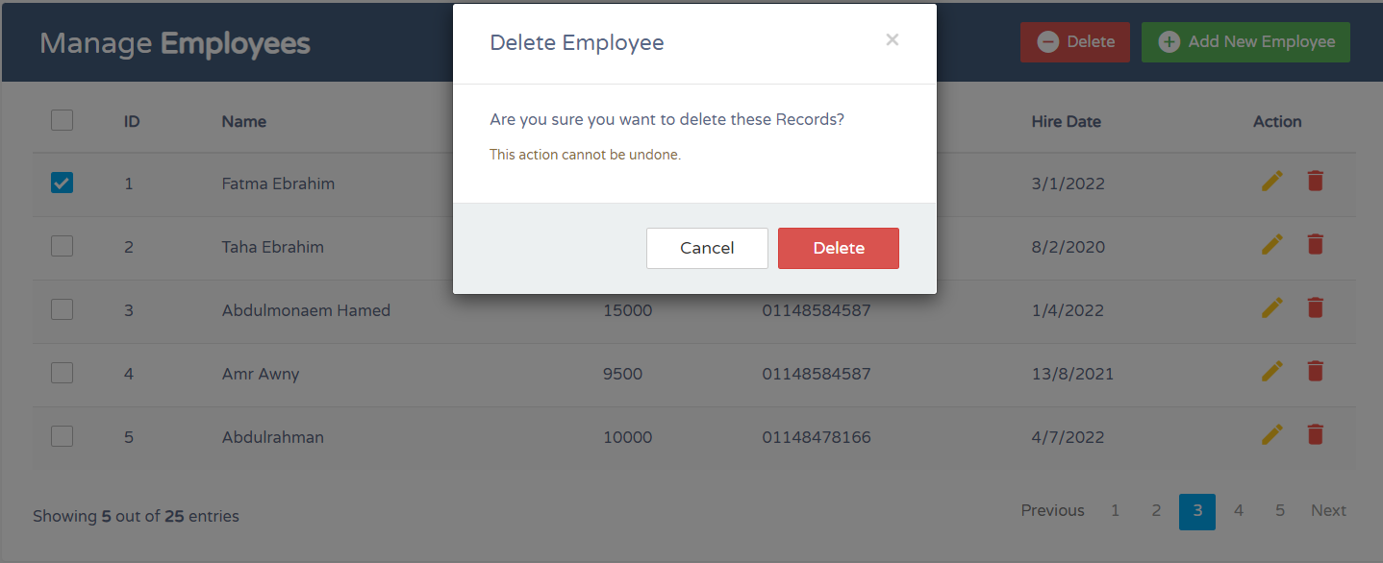
“Delete employee page”

Slide 32
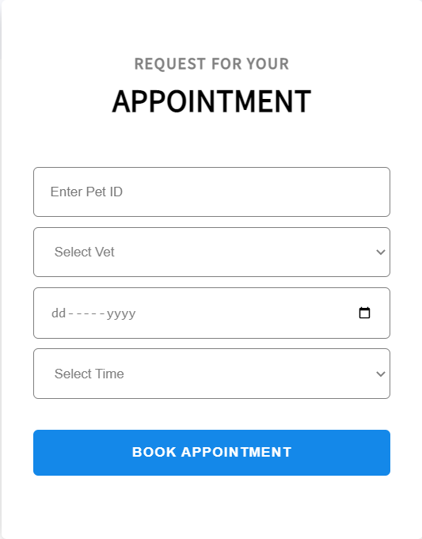
“Book an appointment page”

Slide 33
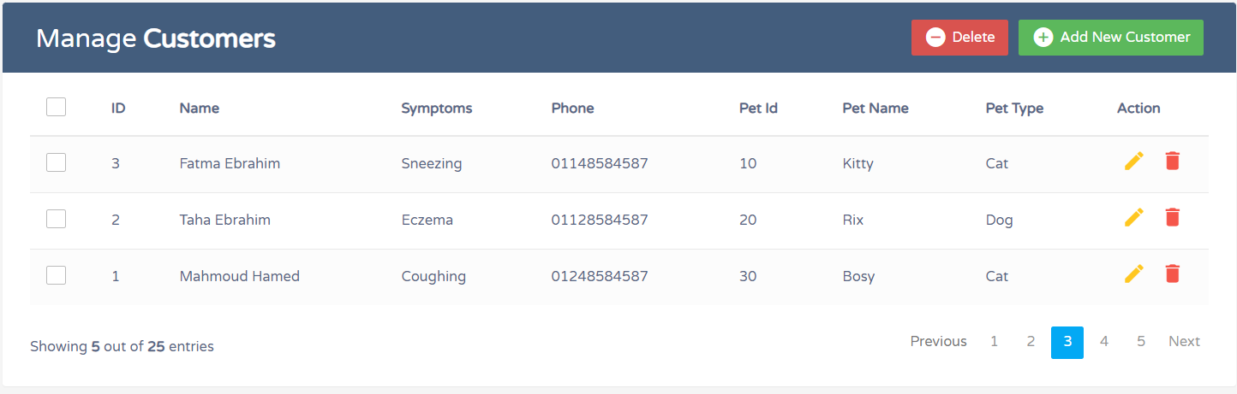
“Manage customers page”

Slide 34
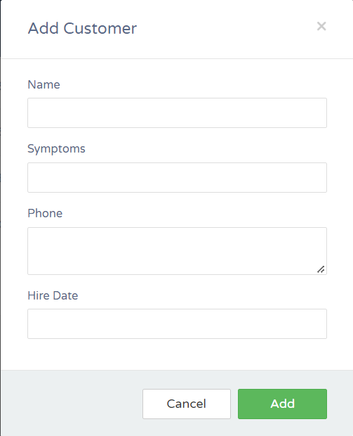
“Add customer page”

Slide 35
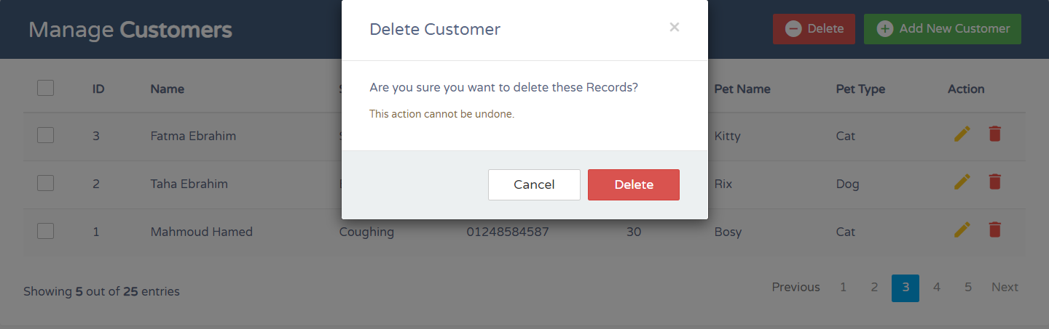
“Delete customer page”

Slide 36
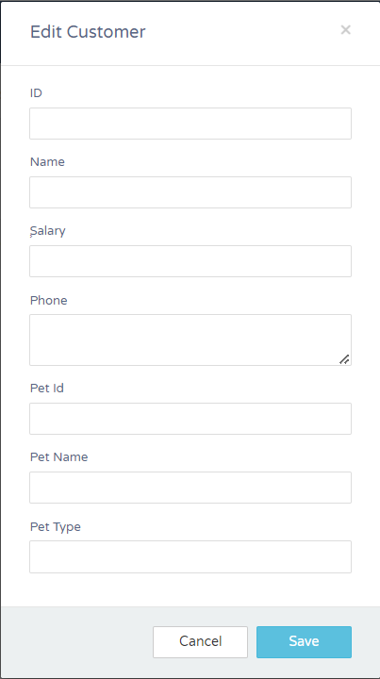
“Edit customer page”

Slide 37
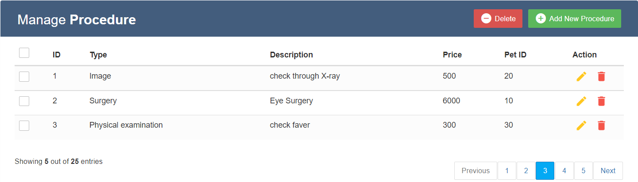
“Manage procedure page”

Slide 38
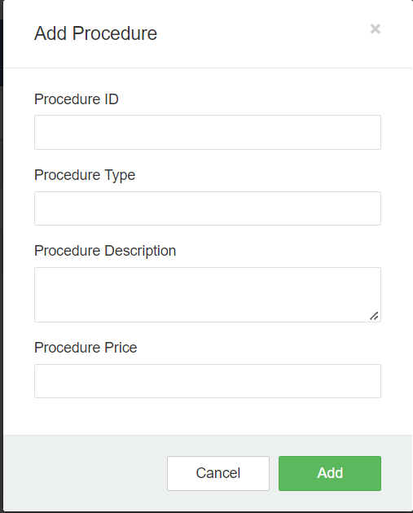
“Add procedure page”

Slide 39
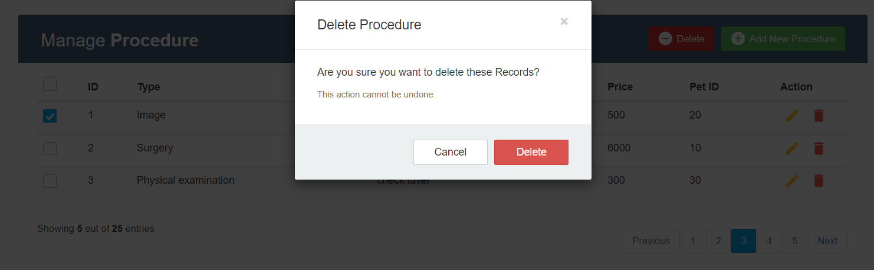
“Delete procedure page”

Slide 40

Team members Taha Ibrahim Fatma Ebrahim Abdulmoneim Hamed Amr Awni Abdulrahman Abdelhady

